Slide 1
Networking
Computer network A collection of computing devices that are connected in various ways in order to communicate and share resources
Usually, the connections between computers in a network are made using physical wires or cables
  However, some connections are wireless, using radio waves or infrared signals

Slide 2
Networking
The generic term node or host refers to any device on a network
Data transfer rate The speed with which data is moved from one place on a network to another
Data transfer rate is a key issue in computer networks

Slide 3
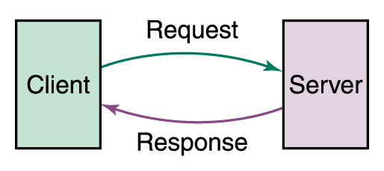
Networking
Computer networks have opened up an entire frontier in the world of computing called the client/server model
Client/Server interaction

Slide 4
Networking
File server A computer that stores and manages files for multiple users on a network
Web server A computer dedicated to responding to requests (from the browser client) for web pages

Slide 5
Types of Networks
Local-area network (LAN) A network that connects a relatively small number of machines in a relatively close geographical area

Slide 6
Types of Networks
Various configurations, called topologies, have been used to administer LANs
  Ring topology A configuration that connects all nodes in a closed loop on which messages travel in one direction
  Star topology A configuration that centers around one node to which all others are connected and through which all messages are sent
  Bus topology All nodes are connected to a single communication line that carries messages in both directions

Slide 7
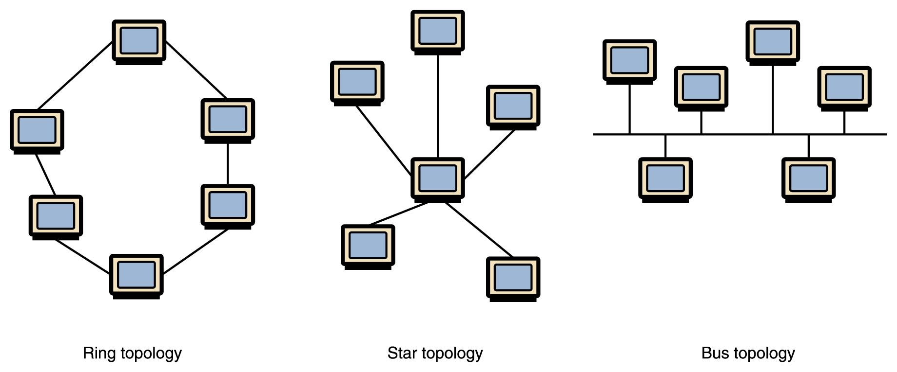
Types of Networks
Various network topologies
A bus technology called Ethernet has become the industry standard for local-area networks

Slide 8
Types of Networks
Wide-area network (WAN) A network that connects two or more local-area networks over a potentially large geographic distance
  Often one particular node on a LAN is set up to serve as a gateway to handle all communication going between that LAN and other networks
Communication between networks is called internetworking
  The Internet, as we know it today, is essentially the ultimate wide-area network, spanning the entire globe

Slide 9
Types of Networks
Metropolitan-area network (MAN) The communication infrastructures that have been developed in and around large cities

Slide 10
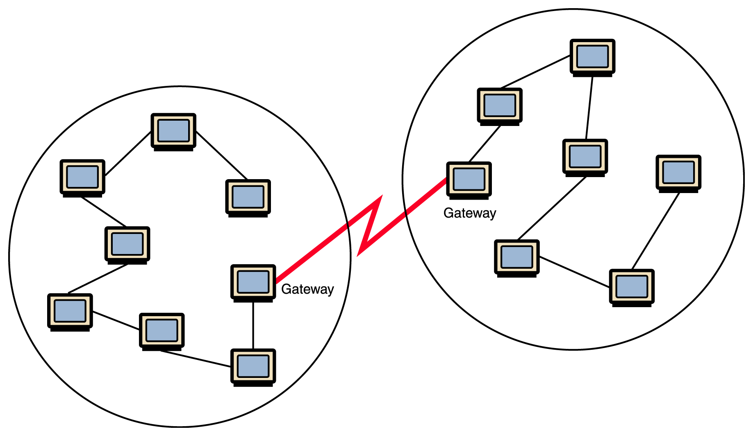
Types of Networks
Local-area networks connected across a distance to create a wide-area network

Slide 11
Internet Connections
Internet backbone A set of high-speed networks that carry Internet traffic
These networks are provided by companies such as AT&T, GTE, and IBM
Internet service provider (ISP) A company that provides other companies or individuals with access to the Internet

Slide 12
Internet Connections
There are various technologies available that you can use to connect a home computer to the Internet
  A phone modem converts computer data into an analog audio signal for transfer over a telephone line, and then a modem at the destination converts it back again into data
  A digital subscriber line (DSL) uses regular copper phone lines to transfer digital data to and from the phone company’s central office
  A cable modem uses the same line that your cable TV signals come in on to transfer the data back and forth

Slide 13
Internet Connections
Broadband A connection in which transfer speeds are faster than 128 bits per second
  DSL connections and cable modems are broadband connections
  The speed for downloads (getting data from the Internet to your home computer) may not be the same as uploads (sending data from your home computer to the Internet)

Slide 14
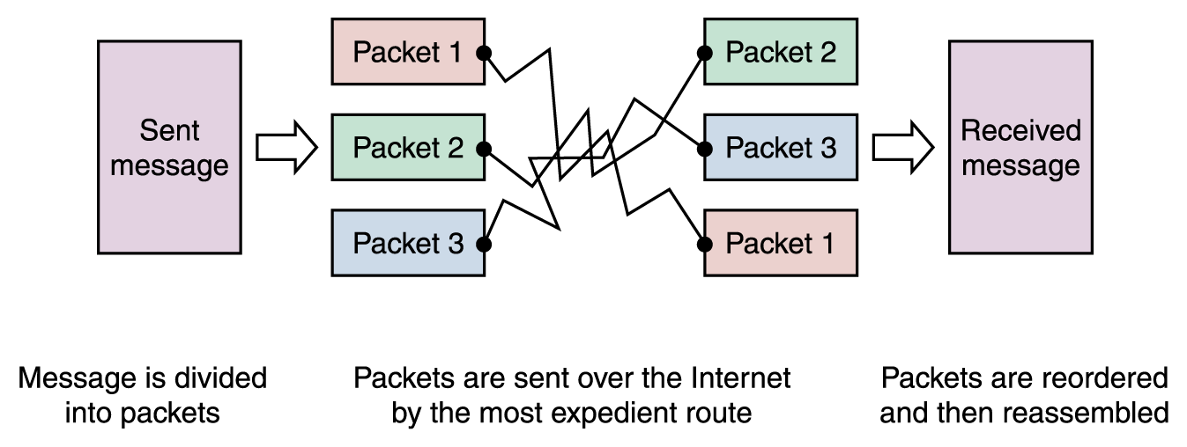
Packet Switching
To improve the efficiency of transferring information over a shared communication line, messages are divided into fixed-sized, numbered packets
Network devices called routers are used to direct packets between networks
Messages sent by packet switching

Slide 15
Open Systems
Proprietary system A system that uses technologies kept private by a particular commercial vendor
  One system couldn’t communicate with another, leading to the need for
Interoperability The ability of software and hardware on multiple machines and from multiple commercial vendors to communicate
  Leading to
Open systems Systems based on a common model of network architecture and a suite of protocols used in its implementation

Slide 16
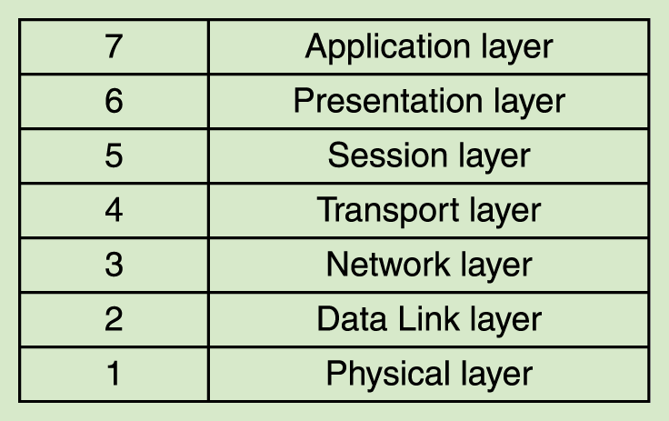
Open Systems
The International Organization for Standardization (ISO) established the Open Systems Interconnection (OSI) Reference Model
Each layer deals with a particular aspect of network communication
The layers of the OSI Reference Model

Slide 17
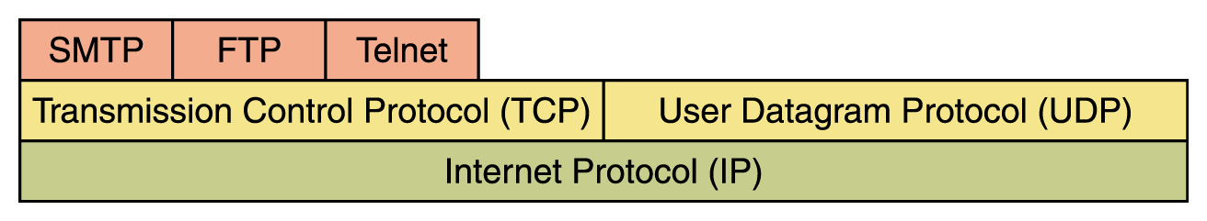
Network Protocols
Network protocols are layered such that each one relies on the protocols that underlie it
Sometimes referred to as a protocol stack
Layering of key network protocols

Slide 18
TCP/IP
TCP stands for Transmission Control Protocol
  TCP software breaks messages into packets, hands them off to the IP software for delivery, and then orders and reassembles the packets at their destination
IP stands for Internet Protocol
  IP software deals with the routing of packets through the maze of interconnected networks to their final destination

Slide 19
TCP/IP (cont.)
UDP stands for User Datagram Protocol
  It is an alternative to TCP
  The main difference is that TCP is highly reliable, at the cost of decreased performance, while UDP is less reliable, but generally faster

Slide 20
High-Level Protocols
Other protocols build on the foundation established by the TCP/IP protocol suite
  Simple Mail Transfer Protocol (SMTP)
  File Transfer Protocol (FTP)
  Telnet
  Hyper Text Transfer Protocol (http)

Slide 21
Firewalls
Firewall A machine and its software that serve as a special gateway to a network, protecting it from inappropriate access
  Filters the network traffic that comes in, checking the validity of the messages as much as possible and perhaps denying some messages altogether
  Enforces an organization’s access control policy

Slide 22
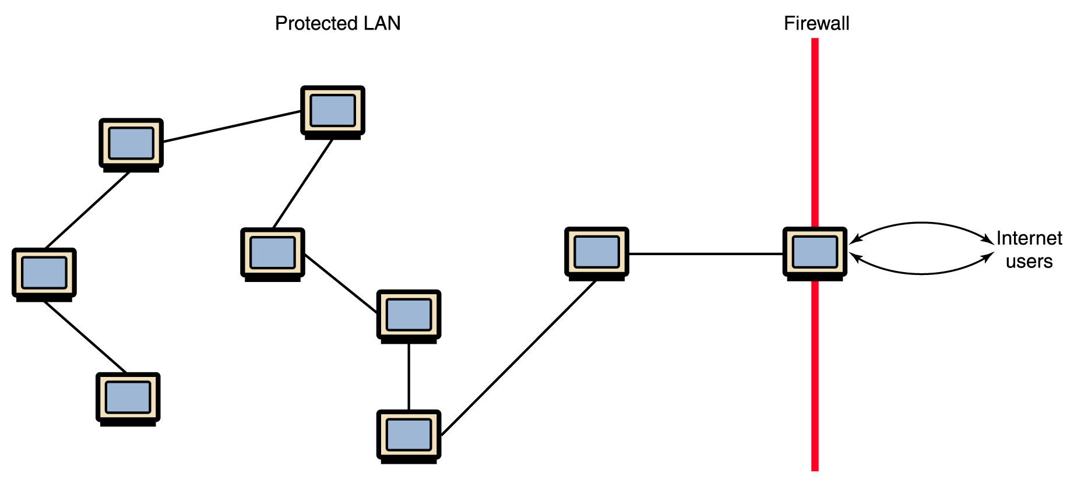
Firewalls
A firewall protecting a LAN

Slide 23
Network Addresses
Hostname A unique identification that specifies a particular computer on the Internet
For example
  matisse.csc.villanova.edu
  condor.develocorp.com

Slide 24
Network Addresses
Network software translates a hostname into its corresponding IP address
For example
  205.39.145.18

Slide 25
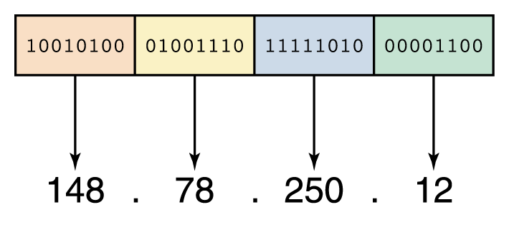
Network Addresses
An IP address can be split into
  network address, which specifies a specific network
  host number, which specifies a particular machine in that network
An IP address is stored in four bytes

Slide 26
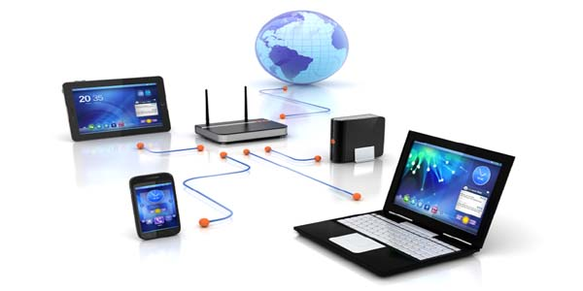
Network Basics
Chapter 1

Slide 27
What is Networking?
Networking is one of the excellent concepts in the field of computers.It enables users at geographical distances to communicate and share data at an excellent speed. This not only reduces time consumption but also reduce the cost of many systems. Networking can be done within a room, organization, city, country or world. The basic purpose of making a network is communication and resource sharing.

Slide 28

What is Computer Network?
Computer network is an interconnection of independent computers in some manner through communication medium to share resources like hardware, software and peripheral devices.

Slide 29
Need of Computer Network?
Now the question arises what is the need of computer network? So,
Computer network is used for connecting computers between various buildings of an organization.
Exchange of data and information amongst the users Via computer network.
In education area and to share information over the geographical wide area.
Also used for sharing software and database.

Slide 30
Advantage
Data transfer and sharing with a wide great speed.
As speed of transfer and sharing is very high, so it reduces the time as well as stationary products too like floppy disk, cd’s etc.
Data encryption is possible with the help of computer network.
Communication is easy with the help of emails.

Slide 31
Disadvantage
Computer are connecting with the help of cables which may also get damage.
Installation cost is very high.
Maintenance cost is high.
Server failure is also a disadvantage of computer network.

Slide 32
Elements of Computer Network
Sender: It is the computer which want to give the message to some one.
Receiver: It is the computer which receives the data from sender who wants to communicate.
Communication Medium: It is the medium through which sender connects to receiver. It can be wire or wireless.
Protocols: Protocols is defined as a set of rules which governs data communication.

Slide 33
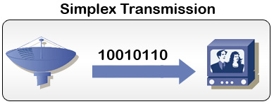
Types of Communication
Communication is only in one direction or in both directions. Based on this communication system is classified as:-
Simplex System(In one direction): Simplex system is a communication mode in which only one signal is transmitted, and it always goes in same direction.

Slide 34
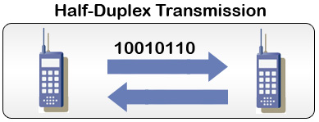
Half Duplex(Bidirectional but not Simultaneously)
A half duplex system provides communication in both direction but not simultaneously i.e once a party begins receiving a signal, it must wait for the transmitter to stop transmitting. E.g. Walkie-talkie.

Slide 35
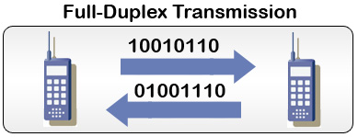
Full Duplex(Bidirectional)
A full duplex system or sometimes called double duplex, allows communication in both direction.
Landlines, mobile phones network or full duplex, since they allows both callers to speak and heard at the same time.

Slide 36
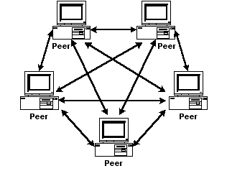
Network Models
Peer to Peer Network: “Peer to peer is a communication model in which each party has the same capabilities and either party can initiate a communication session”. In this individuals have personal machine which are equally powerful.

Slide 37
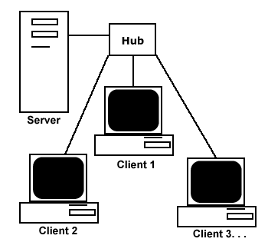
Client Server Network
Client: Individual workstation in a network is client.
Server: Data stored on powerful computers called server who provides services.
In this the data store on powerful computers called servers who provide services. They are maintained and controlled by system administrator , in contrast who wants the services called clients.

Slide 38
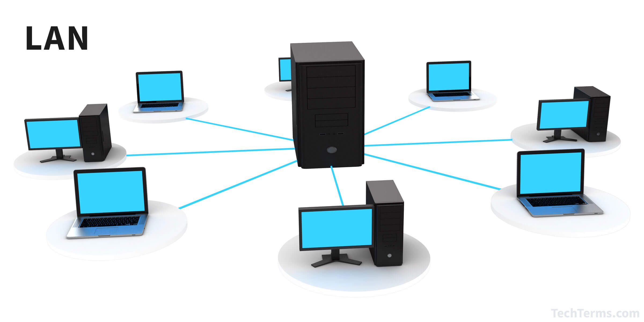
Computer Networks
There are three types of a computer network:
Local Area Network (LAN): LANs are very small networks with a single building or campus of up to few kilometers. The data rate in LAN is of the order of Mbps.

Slide 39
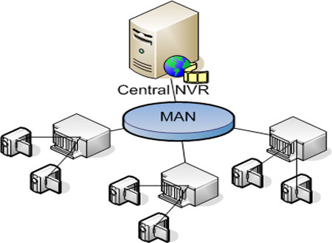
Metropolitan Area Network (MAN)
It is used to connect different LANs in a city: It resides between LAN and WAN. It connects computers within a city or group of nearby corperate offices.The implementations for MAN provides transfer rates from 34Mbps to 150Mbps.

Slide 40
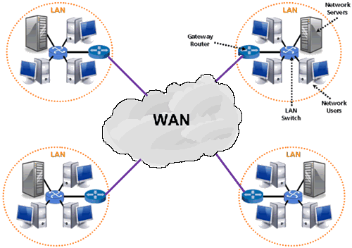
Wide Area Network (WAN)
A wide area network is a connection of two or more computers which are geographically dispersed. It has no longer distance communication than LAN. It uses public network like telephone network or microwave relays for communication facilities.

Slide 41
Network Topologies
It is the way in which the computers are connected in a network is called topology. Network topology is the arrangement of the various elements (links ,nodes etc) of a computer network. There are various network topologies
Star topology
Bus topology
Tree topology
Mesh topology
Ring topology

Slide 42
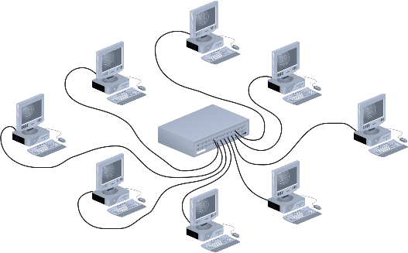
Star Topology
It consist of several devices or computers connected to one centralised computer. This central computer is known as server and other computers connected to server are known as clients or workstation.

Slide 43
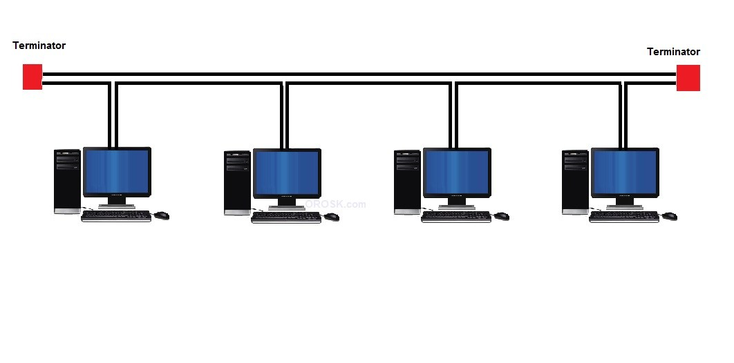
Bus Topology
The Bus topology is also known as horizontal topology.
This topology is very common among local area networks. In this network each computer is connected to a single communication line or cable with an interface. Thus every computer can directly communicate with other computer or device in the network.

Slide 44
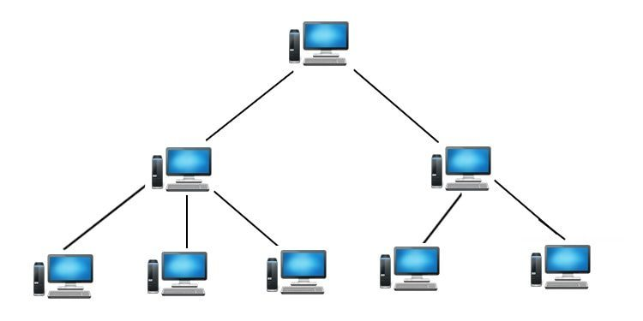
Tree Topology
A tree network links computers in a hierarchical fashion and requires information to flow through the branches. It uses simple software to control the network. The topology provides a concentration point for control and error resolution.

Slide 45
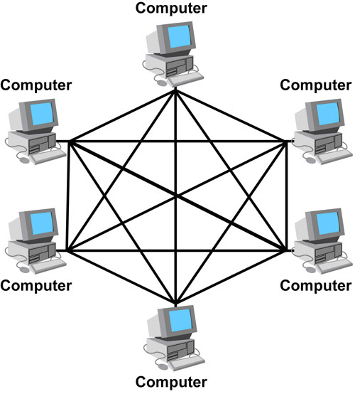
Mesh Topology
In a mesh topology every device has a dedicated point to point link to every other device. A mesh topology in which every device connects to every other is called full mesh. It is robust because the failure of single computer does not bring down the entire network.

Slide 46
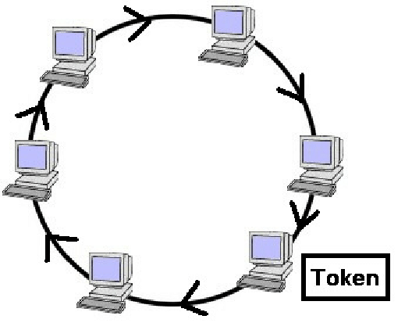
Ring Topology
A ring network consist of several computers or devices connected to each other in a closed loop by a single communication channel. There is no need of central computer or server in this network. The data travels around the ring to each station in turn until it reaches at the desire computer or device.

Slide 47
Switching Techniques
For transmission of data beyond local area, communication is achieved by transmitting data from source to destination through a network of intermediate nodes. Theses nodes are called switching nodes. This method of switching data is called switching. The various switching methods are:
Circuit Switching
Packet Switching
Message Switching

Slide 48
Circuit Switching
There is a direct physical connection between two devices established. Three phases are involved
Circuit establishment: Before any message can be transmitted an end to end circuit must be established.
Data transfer: After the circuit establishment data is transferred through the network.
Circuit disconnect: After some period of data transfer the connection is terminated usually by the action of one of the two stations.

Slide 49
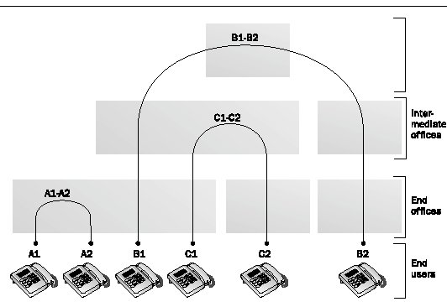

Slide 50
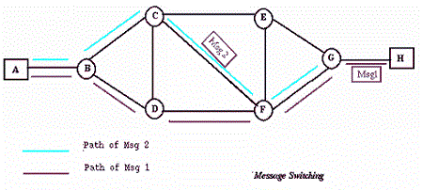
Message Switching
In this no physical path is established between sender and receiver. Instead when sender has the block of the data to send , it is stored in first switching office i.e, router and then forward later. This is also called store and forward network.

Slide 51
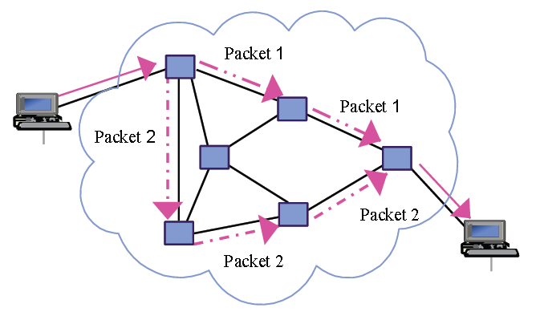
Packet Switching
In this type the message is transmitted in the form of bits of variable length block called packets. The maximum length of packet is established by the network. Each packet contains header with control information along with the data.

Slide 52
OSI MODEL
  Chapter 2

Slide 53
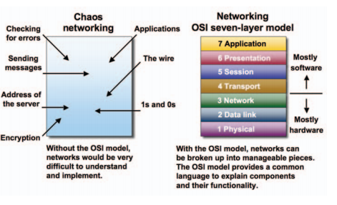
OSI Reference Model
  OSI MODEL:-The Open Systems Interconnection (OSI) model is a reference tool for understanding data communications between any two networked systems. It divides the communications processes into seven layers. Each layer both performs specific functions to support the yers above it and offers services to the layers below it. The three lowest layers focus on passing traffic through the network to an end system.
      overview
                www.globalknowledge.com

Slide 54
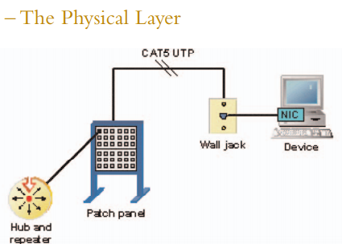
The Physical Layer
The physical layer of the OSI model defines connector and interface specifications, as well as the medium (cable) requirements. Electrical, mechanical, functional, and procedural specifications are provided for sending a bit stream on a computer.

Slide 55
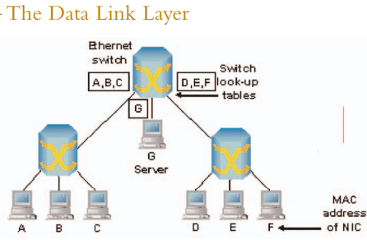
The Data Link Layer
Layer 2 of the OSI model provides the following functions:
• Allows a device to access the network to send and receive messages
• Offers a physical address so a device’s data can be sent on the network
• Works with a device’s networking software when sending and receiving messages
• Provides error-detection capability

Slide 56
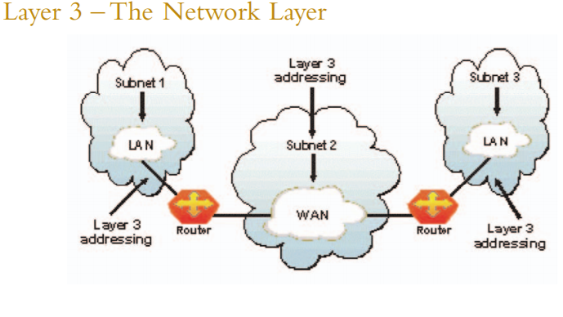
The Network Layer
The network layer of the OSI model, provides an end-to-end logical addressing system so that a packet of data can be routed across several layer 2 networks (Ethernet, Token Ring, Frame Relay, etc.). Note that network layer addresses can also be referred to as logical addresses. Initially, software manufacturers, such as Novell, developed proprietary layer 3 addressing.

Slide 57
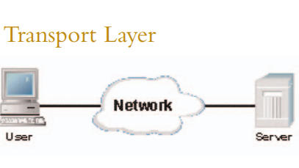
The Transport Layer
the transport layer of the OSI model, offers end-to-end communication between end devices through a network. Depending on the application, the transport layer either offers reliable, connection-oriented or connectionless, best-effort communications. Some of the functions offered by the transport layer include: Application identification
• Client-side entity identification
• Confirmation that the entire

Slide 58
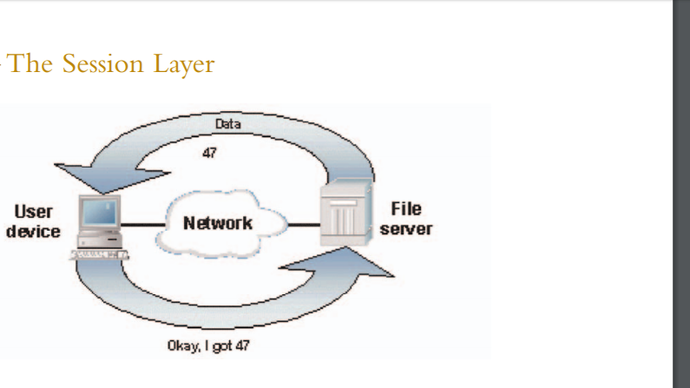
The Session Layer
The session layer, provides various services, including tracking the number of bytes that each end of the session has acknowledged receiving from the other end of the session. This session layer allows applications functioning on devices to establish, manage, and terminate a dialog through a network. Session layer functionality includes:
• Virtual connection between application entities
• Synchronization of data flow
• Creation of dialog units

Slide 59
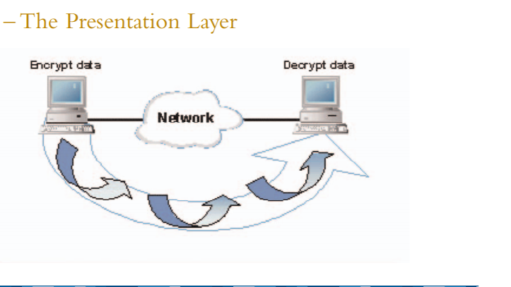
The Presentation Layer
the presentation layer, is responsible for how an application formats the data to be sent out onto the network. The presentation layer basically allows an application to read (or understand) the message. Examples of presentation layer functionality include:
• Encryption and decryption of a message for security
• Compression and expansion of a message so that it travels efficiently
• Graphics formatting
• Content translation
• System-specific translation
www.globalknowledge.com

Slide 60
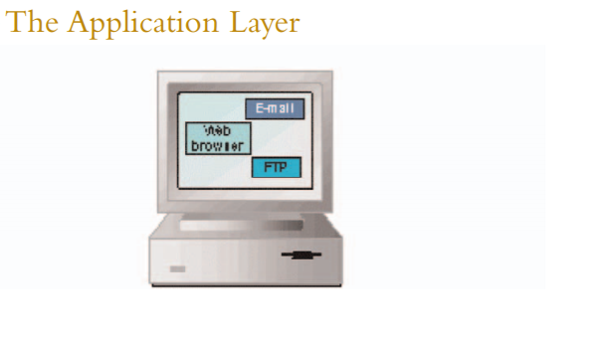
The Application Layer
the application layer, provides an interface for the end user operating a device connected to a network. This layer is what the user sees, in terms of loading an application (such as Web browser or e-mail); that is, this application layer is the data the user views while using these applications. Examples of application layer functionality include:
• Support for file transfers
• Ability to print on a network
• Electronic mail

Slide 61
CHAPTER - 3
INTRODUCTION TO TCP/ IP

Slide 62
INTRODUCTION
TCP stands for transmission control protocol
IP stands for Internet Protocol.

Slide 63
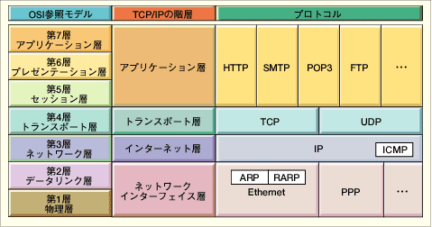
TCP/IP
OSI Model
TCP/IP Hierarchy
Protocols
7th
Application Layer
6th
Presentation Layer
Application Layer
5th
Session Layer
4th
Transport Layer
Transport Layer
3rd
Network Layer
Network Layer
2nd
Link Layer
Link Layer
1st
Physical Layer

Slide 64
DESCRIPTION OF TCP/IP LAYER
TCP/IP model has four layers:
HOST TO HOST NETWORK LAYER
INTERNET LAYER
TRANSPORT LAYER
APPLICATION LAYER

Slide 65
DIFFERENCE BETWEEN OSI AND TCP/IP
Key Differences between TCP/IP and OSI Model
TCP/IP is a client-server model, i.e. when the client requests for service it is provided by the server. Whereas, OSI is a conceptual model.
TCP/IP is a standard protocol used for every network including the Internet, whereas, OSI is not a protocol but a reference model used for understanding and designing the system architecture.
TCP/IP is a four layered model, whereas, OSI has seven layers.
TCP/IP follows Vertical approach. On the other hand, OSI Model supports Horizontal approach.
TCP/IP is Tangible, whereas, OSI is not.
TCP/IP follows top to bottom approach, whereas, OSI Model follows a bottom-up approach.

Slide 66
ADDRESSING
PHYSICAL ADDRESSING
LOGICAL ADDRESSING
IP ADDRESSING.

Slide 67
PHYSICAL ADDRESSING
The address assigned to a network interface card by the original manufacturer or by the network administrator is called physical address or hardware address.

Slide 68
TYPES OF PHYSICAL ADDRESSES
UNICAST ADDRESS
MULTICAST ADDRESS
BROADCAST ADDRESS

Slide 69
Description of physical address types:
UNICAST ADDRESS are permanently assigned to the network interface card(NIC) and are unique for machine.
MULICAST ADDRESSES are the addresses given to a group of hosts instead of single host.
BROADCAST ADDRESSES is an address, which if given in datagram, the message is communicated to all hosts in a network.

Slide 70
LOGICAL ADDRESSING
All logical address is the address which is allocated to an item and can be viewed from perspective of an application program

Slide 71
IP ADDRESSING
The IP address format contains three fields:
Class Type
Network ID
Host ID

Slide 72
IP ADDRESS CLASSES

Slide 73
IP ADDRESS CLASSES
Class A: The first octet is the network portion. Octets 2, 3, and 4 are for subnets/hosts
Class B: The first two octets are the network portion. Octets 3 and 4 are for subnets/hosts
Class C: The first three octets are the network portion. Octet 4 is for subnets/hosts

Slide 74
SUBNETTING IN IP
Creates multiple logical networks that exist within a single Class A, B, or C network.
If you do not subnet, you will only be able to use one network from your Class A, B, or C network, which is unrealistic
Each data link on a network must have a unique network ID, with every node on that link being a member of the same network

Slide 75
SUBNET MASK
Determines the way an IP address is split into network and hosts portions
Class A - 0nnnnnnn.hhhhhhhh.hhhhhhhh.hhhhhhhh
Subnet Mask = 255.0.0.0 IP Address /8
Class B - 10nnnnnn.nnnnnnnn.hhhhhhhh.hhhhhhhh
Subnet Mask = 255.255.0.0 IP Address /16
Class C - 100nnnnn.nnnnnnnn.nnnnnnnn.hhhhhhhh
Subnet Mask = 255.255.255.0 IP Address /24

Slide 76
SUPERNETTING
It is the reverse concept of subnetting. It combines many networks in a region to form a single prefixed address.

Slide 77
IP PACKET FORMAT
The format used by the IP datagrams that carry the data messages in the network is called IP packet format.
An IP datagram consist of a header part and a text part.

Slide 78
IDENTIFY TYPES OF NETWORK CABLES AND CONNECTORS

Slide 79
INTRODUCTION:
you're expected to know the basic concepts of networking as well as the different types of cabling that can be used. For the latter, you should be able to identify connectors and cables from figures even if those figures are crude line art (think shadows) appearing in pop-up boxes.
There are three specific types network cables, and the connectors associated with each, that you must know for this exam: fiber, twisted pair, and coaxial. Fiber is the most expensive of the three and can run the longest distance. A number of types of connectors can work with fiber, but three you must know are SC, ST, and LC.

Slide 80
Twisted pair
Twisted pair is commonly used in office settings to connect workstations to hubs or switches. It comes in two varieties: unshielded (UTP) and shielded (STP), the two types of connectors commonly used are RJ-11 (four wires and popular with telephones), and RJ-45 (eight wires and used with xBaseT networks—100BaseT, 1000BaseT, and so forth). Two common wiring standards are T568A and T568B.
Coaxial cabling is not as popular as it once was, but it's still used with cable television and some legacy networks. The two most regularly used connectors are F-connectors (television cabling) and BNC (10Base2, and so on).

Slide 81
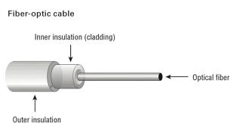
Fiber optics
Fiber-optic cabling is the most expensive type of those discussed for this exam. Although it's an excellent medium, it's often not used because of the cost of implementing it. It has a glass core within a rubber outer coating and uses beams of lightrather than electrical signals to relay data. Because light doesn't diminish over distance the way electrical signals do, this cabling can run for distances measured in kilometers with transmission speeds from 100 Mbps up to 1 Gbps higher.

Slide 82
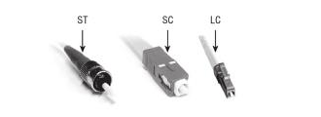
Connectors: SC, ST, and LC
Often, fiber is used to connect runs to wiring closets where they break out into UTP or other cabling types, or as other types of backbones. Fiber-optic cable can use either ST, SC, or LC connector. ST is a barrel-shaped connector, whereas SC is squared and easier to connect in small spaces. The LC connector looks similar to SC but adds a flange on the top (much like an RJ-45 connector) to keep it securely connected.
Note: In addition to these listed in the A + objectives, other connectors are used with fiber. FC connectors may also be used but are not as common. MT-RJ is a popular connector for two fibers in a small form factor.

Slide 83
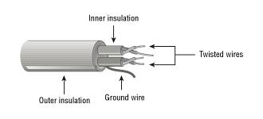
TWISTED PAIR
There are two primary types of twisted-pair cabling (with categories beneath cach that are shielded twisted pair (STP) and unshielded twisted pair (UTP). In both cases, the cabling is made up of pairs of wires twisted around each other.
UTP offers no shielding (hence the name) and is the network cabling type most prone to outside interference. The interference can be from a fluorescent light ballast, electrical motor, or other such source (known as electromagnetic interference [EMI]) or from wires being too close together and signals jumping across them (known as crosstalk), STP adds a foil shield around the twisted wires to protect against EMI.

Slide 84
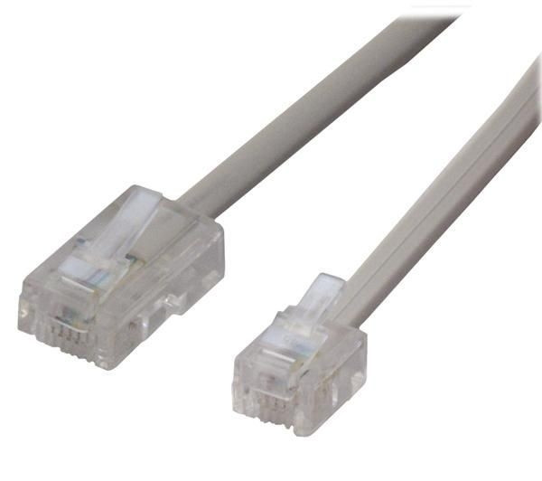
CONNECTOR : RJ-11, RJ-45
STP cable uses IBM data connector (IDC) or universal data connector (UDC) ends and connects to token ring networks. While you need to know STP for the exam, you are not required to have any knowledge of the connectors associated with it. You must, however, know that most UTP cable uses RJ-45 connectors, which look like telephone connectors (RJ-11) but have eight wires instead of four

Slide 85
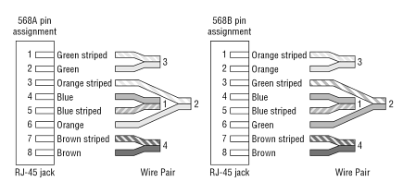
WIRING STANDARDS: T568A, T568B
Two wiring standards are commonly used with twisted-pair cabling: T568A and T568B (sometimes referred to simply as 568A and 568B). These are telecommunications standards from TIA and EIA that specify the pin arrangements for the RJ-45 connectors on UTP or STP cables. The number 568 refers to the order in which the wires within the Category 5 cable are terminated and attached to the connector. The signal is identical for both.
T568A was the first standard, released in 1991. Ten years later, in 2001, T568B was released. Pin numbers are read left to right, with the connector tab facing down. Notice that the pin-outs stay the same, and the only difference is in the color coding of the wiring.

Slide 86
Note:
Mixing cables can cause communication problems on the network. Before installing a network or adding a new component to it, make sure the cable being used is in the correct wiring standard.

Slide 87
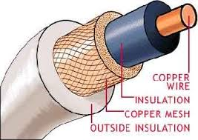
COAXIAL
Coaxial cable, or coax, is one of the oldest media used in networks. Coax is built around a center conductor or core that is used to carry data from point to point. The center conductor has an insulator wrapped around it, a shield over the insulator, and a nonconductive sheath around the shielding. This construction, allows the conducting core to be relatively free from outside interference. The shielding also prevents the conducting core from emanating signals externally from the cable.

Slide 88
INTRODUCTION
Network architecture is a set of layers and protocols to reduce the comprising.
The data passes to the lowest layer by adding some control information. This is done till the last layer.

Slide 89
LOCAL AREA NETWORK(LAN)
ETHERNET:
Ethernet is a LAN architecture which was developed by Xerox. And extended by joint venture of DEC,IC and Xerox. It is specified by IEEE 802.3 and it defines 2 categories, these categories are:
Baseband
Broadband

Slide 90
ELECTRICAL SPECIFICATIONS FOR ETHERNET
Various electrical specification of Ethernet are as follows:
Signaling:
Baseband system is used Manchester digital encoding while the broadband system use differential PSK.
2. Data rate:
the Ethernet LANs support a data rate between one mbps to 100mbps. Basebands define data rate of 1,10 and 100 mbps while broadband defines a data rate of 10 m,bps.
3. Frame format:
The IEEE 802.3 specifies only one type of frame format that include 7 fields.

Slide 91
ETHERNET SPECIFICATIONS
There are six Ethernet specifications as 10 base T, 10 base 5, 10 base2, 1base 5,100 base T and 10 broad 36.

Slide 92
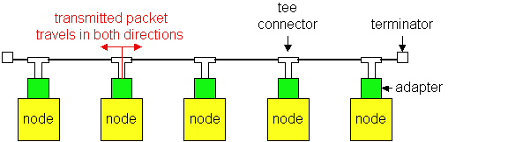
Ethernet Technologies: 10Base2
10: 10Mbps; 2: under 185 (~200) meters cable length
Thin coaxial cable in a bus topology
Repeaters used to connect multiple segments
  Repeater repeats bits it hears on one interface to its other interfaces: physical layer device only!
CS 640
92

Slide 93
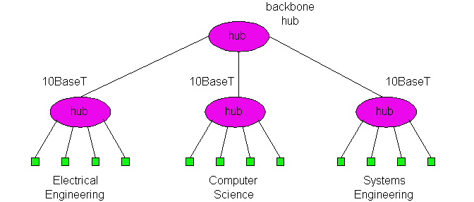
10BaseT and 100BaseT
10/100 Mbps rate
T stands for Twisted Pair
Hub(s) connected by twisted pair facilitate “star topology”
  Distance of any node to hub must be < 100M
CS 640
93

Slide 94
Switched Ethernet
Switches forward and filter frames based on LAN addresses
  It’s not a bus or a router (although simple forwarding tables are maintained)
Very scalable
  Options for many interfaces
  Full duplex operation (send/receive frames simultaneously)
Connect two or more “segments” by copying data frames between them
  Switches only copy data when needed
    key difference from repeaters
Higher link bandwidth
  Collisions are completely avoided
Much greater aggregate bandwidth
  Separate segments can send at once
CS 640
94

Slide 95
Physical Layer Configurations for 802.3
Physical layer configurations are specified in three parts
Data rate (10, 100, 1,000)
  10, 100, 1,000Mbps
Signaling method (base, broad)
  Baseband
    Digital signaling
  Broadband
    Analog signaling
Cabling (2, 5, T, F, S, L)
  5 - Thick coax (original Ethernet cabling)
  F – Optical fiber
  S – Short wave laser over multimode fiber
  L – Long wave laser over single mode fiber
CS 640
95

Slide 96
Our Focus is Ethernet
History
  Developed by Bob Metcalfe and others at Xerox PARC in mid-1970s
  Roots in Aloha packet-radio network
  Standardized by Xerox, DEC, and Intel in 1978
  LAN standards define MAC and physical layer connectivity
    IEEE 802.3 (CSMA/CD - Ethernet) standard – originally 2Mbps
    IEEE 802.3u standard for 100Mbps Ethernet
    IEEE 802.3z standard for 1,000Mbps Ethernet
CSMA/CD: Ethernet’s Media Access Control (MAC) policy
  CS = carrier sense
    Send only if medium is idle
  MA = multiple access
  CD = collision detection
    Stop sending immediately if collision is detected
CS 640
96

Slide 97
State Diagram for CSMA/CD
Packet?
No
Sense Carrier
Send
Detect Collision
Yes
Discard Packet
Jam channel b=CalcBackoff(); wait(b);
attempts++;
attempts < 16
attempts == 16
CS 640
97

Slide 98
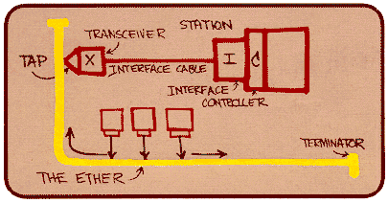
Ethernet Standard Defines Physical Layer
802.3 standard defines physical layer details
Metcalfe’s original
Ethernet Sketch
CS 640
98

Slide 99
Ethernet Problems
Ethernet’s peak utilization is pretty low (like Aloha)
Peak throughput worst with
  More hosts
    More collisions needed to identify single sender
  Smaller packet sizes
    More frequent arbitration
  Longer links
    Collisions take longer to observe, more wasted bandwidth
  Efficiency is improved by avoiding these conditions
CS 640
99

Slide 100
Ethernet Overview
Most popular packet-switched LAN technology
Bandwidths: 10Mbps, 100Mbps, 1Gbps
Max bus length: 2500m
  500m segments with 4 repeaters
Bus and Star topologies are used to connect hosts
  Hosts attach to network via Ethernet transceiver or hub or switch
    Detects line state and sends/receives signals
  Hubs are used to facilitate shared connections
  All hosts on an Ethernet are competing for access to the medium
    Switches break this model
Problem: Distributed algorithm that provides fair access
CS 640
100

Slide 101
Ethernet Overview (contd.)
Ethernet by definition is a broadcast protocol
  Any signal can be received by all hosts
  Switching enables individual hosts to communicate
Network layer packets are transmitted over an Ethernet by encapsulating
Frame Format
64
48
48
16
32
Preamble
Dest
Src
Type
Body
CRC
addr
addr
CS 640
101

Slide 102
INTRODUCTION TO MEDIA CONNECTIVITY
1.VSAT(very small aperture terminal):
It is two satellite ground station with dish antina that is smaller than 3 meters. Most VSAT antina range from 75cm to 1.2m.
CHARACTERISTIC: it uses
*band c having frequency 3 to 7 GHz. The delivered power is low and rainfall effect is minimum.
*band Ku having freq. 10 to 18 GHz. The delivered.power is medium and rainfall is medium.

Slide 103
2.PSTN(public switched telephone network):
home telephone is connected to a circuit switch network via n exchange through a local loop.
The two wire connections between each subscribers telephone and end office is known a local loop.
3.DSL(digital subscriber line):
technology through which local loop telephone line of telecom network is used to accomplish high speed delivery of data. Data video voice and multimedia is called DSL. The link between subscriber and network is analog line.

Slide 104
3.OPTICAL FIBER:
It is a medium to transmit data at high rates. Noise resistance high bandwidth.
Expensive compared to other types of cable.
4.RF(RADIO FREQUENCY):
RF can travel through air or space but require specific transmitting mechanism. It has frequency between 3KHz to 300GHz.
5. ISDN (integrated services digital network):
ISDN was developed by ITU-T in 1976.
It is set of protocols that combines digital telephony and data transport services.

Slide 105

NETWORK DEVICES

Slide 106
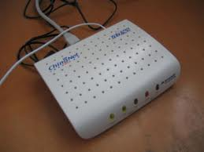
Modem
A modem is a computer peripheral that
allows us to connect
and communicate with other computers
via
telephone lines.
In other words, Modem (Modulator-Demodulator)
is a communication device
that converts binary signal into analog signals (Modulation)
for transmission over the telephone lines and converts
these analog signals back into binary form ( Demodulation)
at the receiving end.

Slide 107
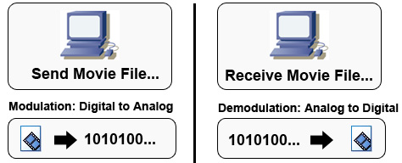
WORKING OF MODEM
MODEM
DCE
MODEM
DCE
DTE
TELEPHONE LINES
DTE

Slide 108
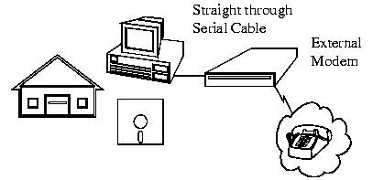
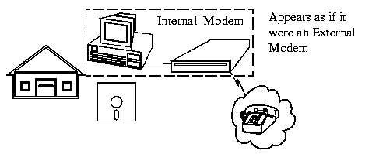
TWO BASIC PHYSICAL TYPES OF MODEM:
1. INTERNAL MODEM:
2. EXTERNAL MODEM:
Modems that are fixed within the computers. The advantage of an internal modem is the lack of extra wires required for installation. Internal modems get their power from the computer's power supply.
Modems connected externally to the computer. External modems require a power source and extra wires to connect to the computer. The advantage of external modems is that they feature lights on the front so you can monitor the connection status. Internal modems cannot be viewed from outside the computer except in the back of the unit.

Slide 109
HUB
A Hub is a hardware device used to connect several
computers together. A hub contains multiple ports.
Hubs are either Passive or Active.
ACTIVE HUBS:
Electrically amplifies the signal as it moves from one connected device to the other.
PASSIVE HUBS:
Allows the signal to pass from one computer to another without any change.

Slide 110
FUNCTIONING OF A HUB:
Hubs forward any data packets – including e-mail, word documents, spreadsheets, graphics- they receive over one port to all of the remaining ports. All users connected to a single hub are in the same segment.

Slide 111
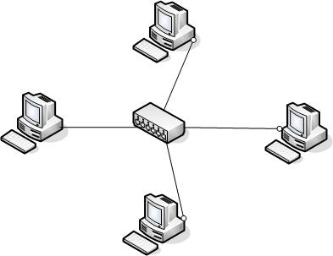
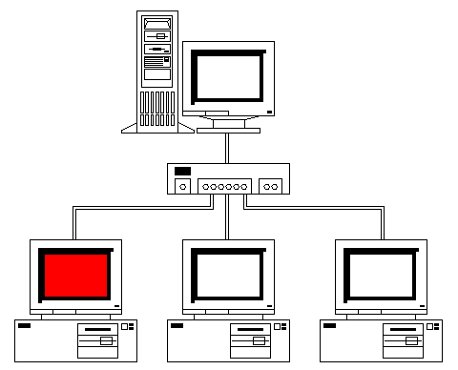

Slide 112
Networking Devices
Repeaters
Hubs
Multiplexers
Switches
Gate ways
NICs
Bridges www.csl.mtu.edu
Routers

Slide 113

SWITCH
A switch is a device that is used to segment networks into subnetworks called subnets.
Allow different nodes of a network to communicate directly with each other.
Allow several users to send information over a network at the same time without slowing each other down.
Responsible for filtering-transforms data in a specific way and for forwarding packets between LAN segments.

Slide 114
REPEATER:
What internetworking devices operate at the physical layer (layer 1) of the OSI model?
When signals first leave a transmitting station, they are clean and easily recognizable. However, the longer the cable length, the weaker and more deteriorated the signals become as they pass along the networking media.
Repeaters can be installed along the way to ensure that data packets reach destination

Slide 115
What is the disadvantage associated with using a repeater?
it can't filter network traffic. Data, sometimes referred to as bits, arriving at one port of a repeater gets sent out on all other ports
data gets passed along by a repeater to all other LAN segments of a network regardless of whether it needs to go there or not.

Slide 116
What internetworking device can be used to filter traffic on the network?
One way to solve the problems of too much traffic on a network and too many collisions is to use an internetworking device called a bridge.
A bridge eliminates unnecessary traffic and minimizes the chances of collisions occurring on a network by dividing it into segments

Slide 117
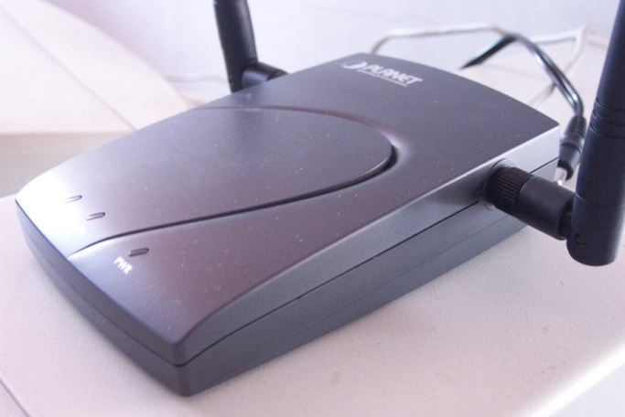


Slide 118


Slide 119

At what layer of the OSI model do bridges operate?
Because bridges operate at the data link layer, layer 2, they are not required to examine upper-layer information.

Slide 120
How are bridge data-forwarding decisions limited?
Although bridges use tables to determine whether or not to forward data to other segments of the network, the types of comparisons and decisions they make are relatively low level, simple ones

Slide 121
What types of network traffic problems is a bridge incapable of solving?
Bridges work best where traffic from one segment of a network to other segments is not too great.
However, when traffic between network segments becomes too heavy, the bridge can become a bottleneck and actually slow down communication.

Slide 122

What are routers?
Routers are another type of internetworking device.
These devices pass data packets between networks based on network protocol or layer 3 information.
Routers have the ability to make intelligent decisions as to the best path for delivery of data on the network.

Slide 123


Slide 124
What network problems can routers help resolve?
The problem of excessive broadcast traffic can be solved by using a router.
Routers are able to do this, because they do not forward broadcast frames unless specifically told to do so

Slide 125
How do routers differ from bridges?
Routers differ from bridges in several respects. First, bridging occurs at the data link layer or layer 2,while routing occurs at the network layer or layer 3 of the OSI model.
Second, bridges use physical or MAC addresses to make data forwarding decisions. Routers use a different addressing scheme that occurs at layer three

Slide 126
How do routers work?
Routers are used to connect two or more networks. For routing to be successful, each network must have a unique network number

Slide 127
gatewaY
Device that connects dissimilar networks.
Operates at the highest level of
abstraction.
Expands the functionality of routers by
performing data translation and
protocol conversion.
Needed to convert Ethernet traffic from
LAN to San(Systems Network
Architecture)traffic legacy system.
Then routes the SNA traffic to the
mainframe.
When Mainframe answers, Reverse
process occurs.
Establishes an intelligent connection between a
local network and external networks with
completely different structures.

Slide 128
Repeaters
5-4-3 Rule
The maximum path between 2 stations on the network should not be more than 5 segments with 4 repeaters between those segments and no more than 3 populated segments.
Repeaters
Host A
Host Z

Slide 129

Bridges
Bridges are used to connect separate segments of a network.
Bridges implement the Spanning-Tree Protocol to build a loop free network topology. This means that on a network ,one or more bridges may be blocked if they are forming a loop . Bridges communicate with each other, exchanging information such as priority and bridge interface MAC address. They select a root bridge and then implement the Spanning-Tree Protocol.
Blocking
x
Bridges
Blocking
x

Slide 130
WIRELESS NETWORKING
Chapter 7

Slide 131
Wireless LAN
A wireless LAN is defines as wireless local area network, which may be defined as connection of two or more computers without using wires.
Wireless LANS connect computer networks via radio transmissions intead of traditional phone lines or cables

Slide 132

History of Wireless Network
It is an important form of connection in many business areas.
Earlier it was very expensive and used only in the places where cabling was difficult.
Now WLAN uses protocols like versions of IEEE 802.11

Slide 133
WLAN/IEEE 802.11
IEEE 802.11 is a set of media access control (MAC) and physical layer (PHY) specifications for implementing wireless local area network (WLAN) computer communication in the 900 MHz and 2.4, 3.6, 5, and 60 GHz frequency bands.
https://en.wikipedia.org/wiki/IEEE_802.11

Slide 134
IEEE 802.11 Standards
802.11 — applies to wireless LANs and provides 1 or 2 Mbps transmission in the 2.4 GHz band using either frequency hopping spread spectrum (FHSS) or direct sequence spread spectrum (DSSS).
802.11a — an extension to 802.11 that applies to wireless LANs and provides up to 54-Mbps in the 5GHz band. 802.11a uses an orthogonal frequency division multiplexing encoding scheme rather than FHSS or DSSS.
802.11b (also referred to as 802.11 High Rate or Wi-Fi) — an extension to 802.11 that applies to wireless LANS and provides 11 Mbps transmission (with a fallback to 5.5, 2 and 1-Mbps) in the 2.4 GHz band. 802.11b uses only DSSS. 802.11b was a 1999 ratification to the original 802.11 standard, allowing wireless functionality comparable to Ethernet.
802.11e — a wireless draft standard that defines the Quality of Service (QoS) support for LANs, and is an enhancement to the 802.11a and 802.11b wireless LAN (WLAN) specifications. 802.11e adds QoS features and multimedia support to the existing IEEE 802.11b and IEEE 802.11a wireless standards, while maintaining full backward compatibility with these standards.
802.11g — applies to wireless LANs and is used for transmission over short distances at up to 54-Mbps in the 2.4 GHz bands.
802.11n — 802.11n builds upon previous 802.11 standards by adding multiple-input multiple-output(MIMO). The additional transmitter and receiver antennas allow for increased data throughput through spatial multiplexing and increased range by exploiting the spatial diversity through coding schemes like Alamouti coding

Slide 135
IEEE 802.11 Standards
802.11ac — 802.11ac builds upon previous 802.11 standards, particularly the 802.11n standard, to deliver data rates of 433Mbps per spatial stream, or 1.3Gbps in a three-antenna (three stream) design. The 802.11ac specification operates only in the 5 GHz frequency range and features support for wider channels (80MHz and 160MHz) and beamforming capabilities by default to help achieve its higher wireless speeds.
802.11ac Wave 2 — 802.11ac Wave 2 is an update for the original 802.11ac spec that uses MU-MIMOtechnology and other advancements to help increase theoretical maximum wireless speeds for the spec to 6.93 Gbps.
802.11ad — 802.11ad is a wireless specification under development that will operate in the 60GHz frequency band and offer much higher transfer rates than previous 802.11 specs, with a theoretical maximum transfer rate of up to 7Gbps (Gigabits per second).
802.11ah— Also known as Wi-Fi HaLow, 802.11ah is the first Wi-Fi specification to operate in frequency bands below one gigahertz (900 MHz), and it has a range of nearly twice that of other Wi-Fi technologies. It's also able to penetrate walls and other barriers considerably better than previous Wi-Fi standards.
802.11r - 802.11r, also called Fast Basic Service Set (BSS) Transition, supports VoWi-Fi handoff between access points to enable VoIP roaming on a Wi-Fi network with 802.1X authentication.
802.1X — Not to be confused with 802.11x (which is the term used to describe the family of 802.11 standards) 802.1X is an IEEE standard for port-based Network Access Control that allows network administrators to restricted use of IEEE 802 LAN service access points to secure communication between authenticated and authorized devices.
https://www.webopedia.com/TERM/8/802_11.html

Slide 136
Wireless LAN Protocols
MACA, a wireless network node announces that it is going to send the data frame, informing the other nodes to remain silent. When a node intends to transmit the data frame, it communicates using a signal known as Request-To-Send (RTS) that includes the length of the data frame to transmit. If the recipient permits the transmission, it responds back to the sender with a signal known as Clear-To-Send (CTS), which includes the length of the data frame that it is about to receive.
In the meantime, the nodes that listen to the RTS signal must remain silent until the data is fully transmitted in order to avoid conflict with CTS. Collisions among RTS packets may still occur in MACA, but they are minimized using a randomized exponential back-off strategy, much like the one that is used in regular Carrier Sense Multiple Access (CSMA).

Slide 137
Wireless LAN Protocols
Although collisions can occur between RTS packets, MACA still has an edge over CSMA, provided that the RTS packets are substantially smaller compared to the data packets. If the RTS packets are significantly smaller, the collisions between RTS packets create less impact.
WLAN data transmission collisions can still happen, and MACA for Wireless (MACAW) is brought to extend the functionality of MACA. It demands nodes to send acknowledgments after every successful frame transmission. MACAW is commonly used in ad hoc networks. Moreover, it is the basis of various other MAC protocols found in wireless sensor networks (WSN).
https://www.techopedia.com/

Slide 138
Benefites of Wireless LAN
Mobility
Mobility enables users to physically move while using an appliance, such as a handheld PC or data collector. Many jobs require workers to be mobile—these include inventory clerks, healthcare workers, policemen, and emergency care specialists. Of course, wireline networks require a physical tether between the user's workstation and the network's resources, which makes access to these resources impossible while roaming about the building or elsewhere. This freedom of movement results in significant return on investments due to gains in efficiency.

Slide 139
Benefites of Wireless LAN
Installation in Difficult-to-Wire Areas
The implementation of wireless networks offers many tangible cost savings when performing installations in difficult-to-wire areas. If rivers, freeways, or other obstacles separate buildings that you want to connect, a wireless solution may be much more economical than installing physical cable or leasing communications circuits, such as T1 service or 56Kbps lines. Some organizations spend thousands or even millions of dollars to install physical links with nearby facilities. If you are facing this type of installation, consider wireless networking as an alternative. The deployment of wireless networking in these situations costs thousands of dollars but will result in a definite cost savings in the long run.

Slide 140
Benefites of Wireless LAN
Increased Reliability
An advantage of wireless networking, therefore, results from the use of less cable. This reduces the downtime of the network and the costs associated with replacing cables.

Slide 141
Benefites of Wireless LAN
Reduced Installation Time
The installation of cabling is often a time-consuming activity. For LANs, installers must pull twisted-pair wires above the ceiling and drop cables through walls to network outlets that they must affix to the wall. These tasks can take days or weeks, depending on the size of the installation. The installation of optical fiber between buildings within the same geographical area consists of digging trenches to lay the fiber or pulling the fiber through an existing conduit. You might need weeks or possibly months to receive right-of-way approvals and dig through ground and asphalt.
The deployment of wireless networks greatly reduces the need for cable installation, making the network available for use much sooner.

Slide 142

Benefits of Wireless LAN
Long-Term Cost Savings
      http://www.informit.com/articles/

Slide 143
Architecture of Wireless LAN
IEEE 802.11 Architecture
The smallest building block of a wireless LAN is a basic service set (BSS), which consists of some number of stations executing the same MAC protocol and competing for access to the same shared wireless medium.
A BSS may isolated or it may connect to a backbone distribution system (DS) through an access point (AP).
The AP functions as a bridge and a relay point. In a BSS, client stations do not communicate directly with one another.
Rather, if one station in the BSS wants to communicate with another station in the same BSS, the MAC frame first sent from the originating station to the AP, and then from the AP to the destination station.

Slide 144
Similarly, a MAC frame from a station in the BSS to a remote station sent from the local station to the AP and then relayed by the AP over the DS on its way to the destination station.
The BSS generally corresponds to what referred to as a cell in the literature. The DS can a switch, a wired network, or a wireless network.
When all the stations in the BSS mobile stations, with no connection to other BSSs, the BSS called an independent BSS (IBSS).
An IBSS is typically an ad hoc network. In an IBSS, the stations all communicate directly, and no AP involved.

Slide 145
A simple configuration is shown in Figure, in which each station belongs to a single BSS; that is, each station is within wireless range only of other stations within the same BSS.
It is also possible for two BSSs to overlap geographically so that a single station could participate in more than one BSS.
Further, the association between a station and a BSS dynamic. Stations may turn off, come within range, and go out of range.
An extended service set (ESS) consists of two or more basic service sets interconnected by a distribution system.
Typically, the distribution system a wired backbone LAN but can any communications network.
The extended service set appears as a single logical LAN to the logical link control (LLC) level.
The figure indicates that an access point (AP) implemented as part of a station; the AP the logic within a station that provides access to the DS by providing DS services in addition to acting as a station.
To integrate the IEEE 802.11 architecture with a traditional wired LAN, a portal used. The portal logic implemented in a device, such as a bridge or a router. That part of the wired LAN and that attached to the DS.

Slide 146

Architecture of Wireless LAN

Slide 147
Components of Architecture
Stations
All components that can connect into a wireless medium in a network are referred to as stations (STA). All stations are equipped with wireless network interface controllers (WNICs). Wireless stations fall into two categories: wireless access points, and clients. Access points (APs), normally wireless routers, are base stations for the wireless network. They transmit and receive radio frequencies for wireless enabled devices to communicate with. Wireless clients can be mobile devices such as laptops, personal digital assistants, IP phones and other smartphones, or non-portable devices such as desktop computers, printers, and workstations that are equipped with a wireless network interface.

Slide 148
Basic service set
The basic service set (BSS) is a set of all stations that can communicate with each other at PHY layer. Every BSS has an identification (ID) called the BSSID, which is the MAC address of the access point servicing the BSS.
There are two types of BSS: Independent BSS (also referred to as IBSS), and infrastructure BSS. An independent BSS (IBSS) is an ad hoc network that contains no access points, which means they cannot connect to any other basic service set.

Slide 149
Components of Architecture
Basic service set
The basic service set (BSS) is a set of all stations that can communicate with each other at PHY layer. Every BSS has an identification (ID) called the BSSID, which is the MAC address of the access point servicing the BSS.
There are two types of BSS: Independent BSS (also referred to as IBSS), and infrastructure BSS. An independent BSS (IBSS) is an ad hoc network that contains no access points, which means they cannot connect to any other basic service set.
Independent basic service set: An IBSS is a set of STAs configured in ad hoc (peer-to-peer)mode.
Extended service set: An extended service set (ESS) is a set of connected BSSs. Access points in an ESS are connected by a distribution system. Each ESS has an ID called the SSID which is a 32-byte (maximum) character string.
Distribution system: A distribution system (DS) connects access points in an extended service set. The concept of a DS can be used to increase network coverage through roaming between cells.
DS can be wired or wireless. Current wireless distribution systems are mostly based on WDS or MESH protocols, though other systems are in use.

Slide 150
Bluetooth Fundamentals
Universal short-range wireless capability
Uses 2.4-GHz band
Available globally for unlicensed users
Devices within 10 m can share up to 720 kbps of capacity
Supports open-ended list of applications
  Data, audio, graphics, video

Slide 151
Architecture of Bluetooth
Piconet
  Basic unit of Bluetooth networking
  Master and one to seven slave devices
  Master determines channel and phase
Scatternet
  Device in one piconet may exist as master or slave in another piconet
  Allows many devices to share same area
  Makes efficient use of bandwidth
  Not implemented in COTS equipment

Slide 152
Applications of Bluetooth
Data and voice access points
  Real-time voice and data transmissions
Cable replacement
  Eliminates need for numerous cable attachments for connection
Ad hoc networking
  Device with Bluetooth radio can establish connection with another when in range
https://learn.sparkfun.com/tutorials/bluetooth-basics

Slide 153

Bluetooth Protocol Stack

Slide 154
Difference in Bluetooth and Wi-Fi
The main difference is that Bluetooth is primarily used to connect devices without using cables, while Wi-Fi provides high-speed access to the internet. Bluetooth is a wireless technology standard that is used to exchange data over short distances (less than 30 feet), usually between personal mobile devices.

Slide 155
New in Bluetooth
Atomic Encryption Change
Extended Enquiry Response
Sniff Rub Rating
Improvements in Quality of Services
Simple Pairing

Slide 156
Bluetooth Security
Bluetooth uses the safer algorithm for authentication and key generation. The EO stream cipher is used for encrypting packets. This makes eavesdropping on Bluetooth enabled devices more difficult for certain classes of devices such as Handheld phones. It uses stronger and asymmetric key establishment methods.

